Slide 1
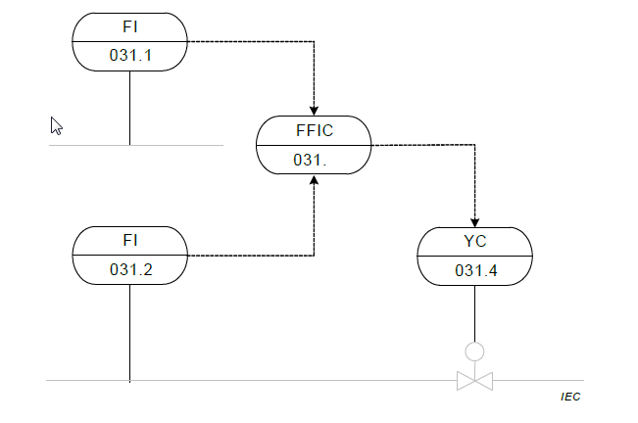
I05 Instrumentation example
Frei verwendbar

